Slide 1
SEMPHY01
RECOMBINATION AND REGENERATION

Slide 2
Review
Carrier Drift
Carrier Diffusion
Generation Recombination / Photoelectric Effect
  Generation of holes and electrons
  Recombination of holes with electrons

Slide 3
Continuity equation
We basically to combine the overall effect of drift, diffusion, and recombination together into a single governing equation.
This governing equation is the continuity equation

Slide 4
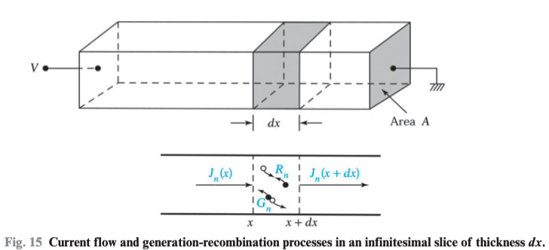

Slide 5
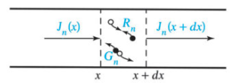
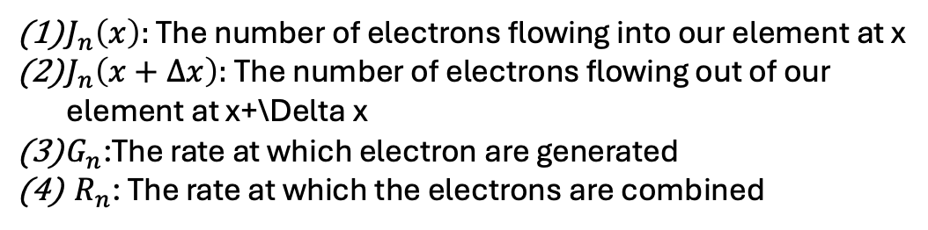
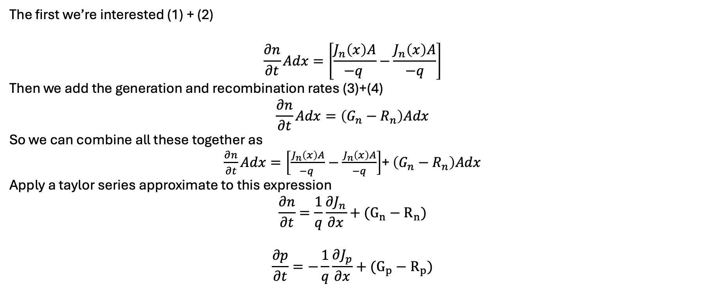
$J_{n}\left(x\right):$ The number of electrons flowing into our element at x
$J_{n}\left(x+Δx\right):$The number of electrons flowing out of our element at x+\Delta x
$G_{n}$:The rate at which electron are generated
${ R}_{n}$: The rate at which the electrons are combined
The first we’re interested (1) + (2)
$$\frac{∂n}{∂t}Adx=\left[\frac{J_{n}\left(x\right)A}{−q }−\frac{J_{n}\left(x\right)A}{−q}\right]$$
Then we add the generation and recombination rates (3)+(4)
$$\frac{∂n}{∂t}Adx=\left(G_{n}−R_{n}\right)Adx$$
So we can combine all these together as
$\frac{∂n}{∂t}Adx=\left[\frac{J_{n}\left(x\right)A}{−q }−\frac{J_{n}\left(x\right)A}{−q}\right]$+ $\left(G_{n}−R_{n}\right)Adx$
Apply a taylor series approximate to this expression
$$\frac{∂n}{∂t}=\frac{1}{q}\frac{∂J_{n}}{∂x}+(G_{n}−R_{n})$$
$$\frac{∂p}{∂t}=−\frac{1}{q}\frac{∂J_{p}}{∂x}+(G_{p}−R_{p})$$
Continuity Equation for holes
And electrons

Slide 6
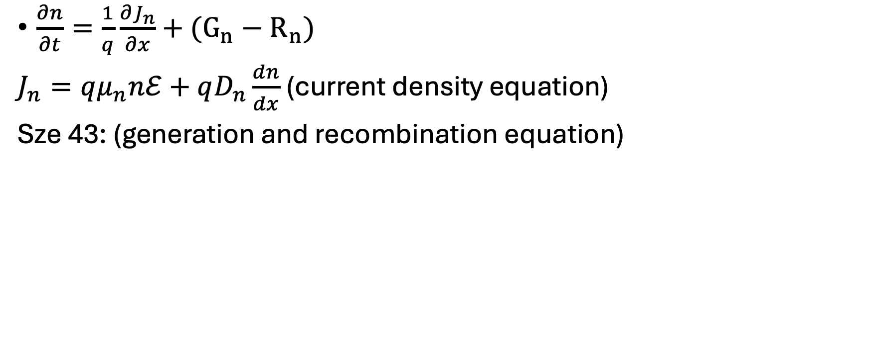
Continuity Equations
$\frac{∂n}{∂t}=\frac{1}{q}\frac{∂J_{n}}{∂x}+(G_{n}−R_{n})$
$J_{n}=qμ_{n}nℰ+qD_{n}\frac{dn}{dx}$ (current density equation)
Sze 43: (generation and recombination equation)

Slide 7
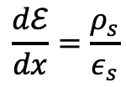
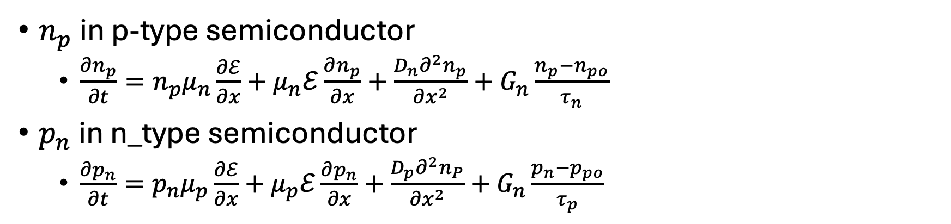

For the minority carriers
$n_{p}$ in p-type semiconductor
  $\frac{∂n_{p}}{∂t}=n_{p}μ_{n}\frac{∂ℰ}{∂x}+μ_{n}ℰ\frac{∂n_{p}}{∂x}+\frac{D_{n}∂^{2}n_{p}}{∂x^{2}}+G_{n}\frac{n_{p}−n_{po}}{τ_{n}}$
$p_{n}$ in n_type semiconductor
  $\frac{∂p_{n}}{∂t}=p_{n}μ_{p}\frac{∂ℰ}{∂x}+μ_{p}ℰ\frac{∂p_{n}}{∂x}+\frac{D_{p}∂^{2}n_{P}}{∂x^{2}}+G_{n}\frac{p_{n}−p_{po}}{τ_{p}}$
Space charge density. ($q\left(p−n\right)+N_{D}^{+}−N_{A}^{−})$
$$\frac{dℰ}{dx}=\frac{ρ_{s}}{ε_{s}}$$
Permitivity of your semiconductor

Slide 8
Cases we’re interested in
Steady state injection from one side
Minority Carriers at the surface
Hayes-Shockley experiment

Slide 9

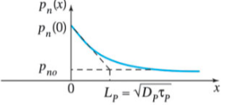
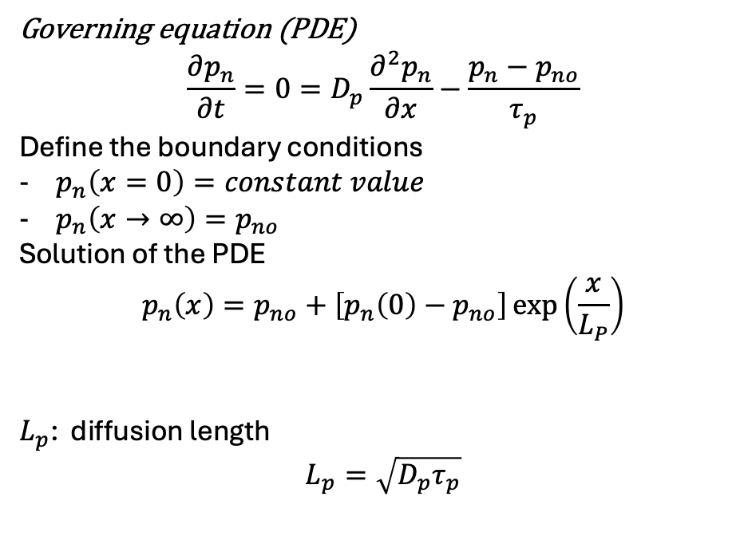
Governing equation (PDE)
$$\frac{∂p_{n}}{∂t}=0=D_{p}\frac{∂^{2}p_{n}}{∂x}−\frac{p_{n}−p_{no}}{τ_{p}}$$
Define the boundary conditions
$p_{n}\left(x=0\right)=constant value$
$p_{n}\left(x→∞\right)=p_{no}$
Solution of the PDE
$$p_{n}\left(x\right)=p_{no}+\left[p_{n}\left(0\right)−p_{no}\right]\exp\left(\frac{x}{L_{P}}\right)$$
$L_{p}$: diffusion length
$$L_{p}=\sqrt{D_{p}τ_{p}}$$

Slide 10
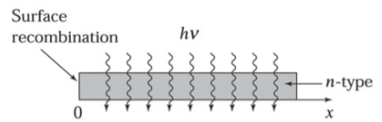
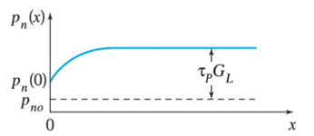
Minority Carriers at the Surface

Slide 11
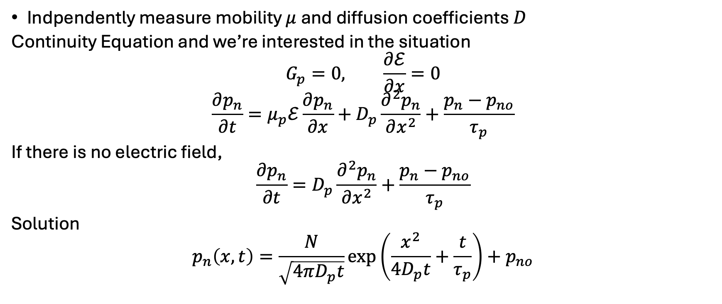
Haynes-Shockley
Indpendently measure mobility $μ$and diffusion coefficients $D$
Continuity Equation and we’re interested in the situation
$$G_{p}=0, \frac{∂ℰ}{∂x}=0$$
$$\frac{∂p_{n}}{∂t}=μ_{p}ℰ\frac{∂p_{n}}{∂x}+D_{p}\frac{∂^{2}p_{n}}{∂x^{2}}+\frac{p_{n}−p_{no}}{τ_{p}}$$
If there is no electric field,
$$\frac{∂p_{n}}{∂t}=D_{p}\frac{∂^{2}p_{n}}{∂x^{2}}+\frac{p_{n}−p_{no}}{τ_{p}}$$
Solution
$$p_{n}\left(x,t\right)=\frac{N}{\sqrt{4πD_{p}t}}\exp\left(\frac{x^{2}}{4D_{p}t}+\frac{t}{τ_{p}}\right)+p_{no}$$

Slide 12
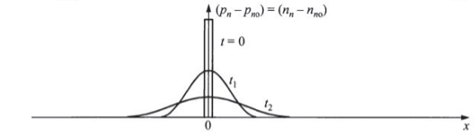
Without an electric field

Slide 13
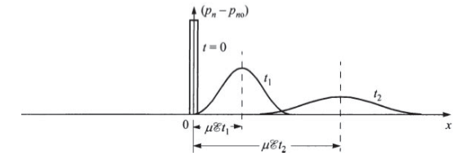
With an electric field

Slide 14
Continuity Equation

